Slide 1
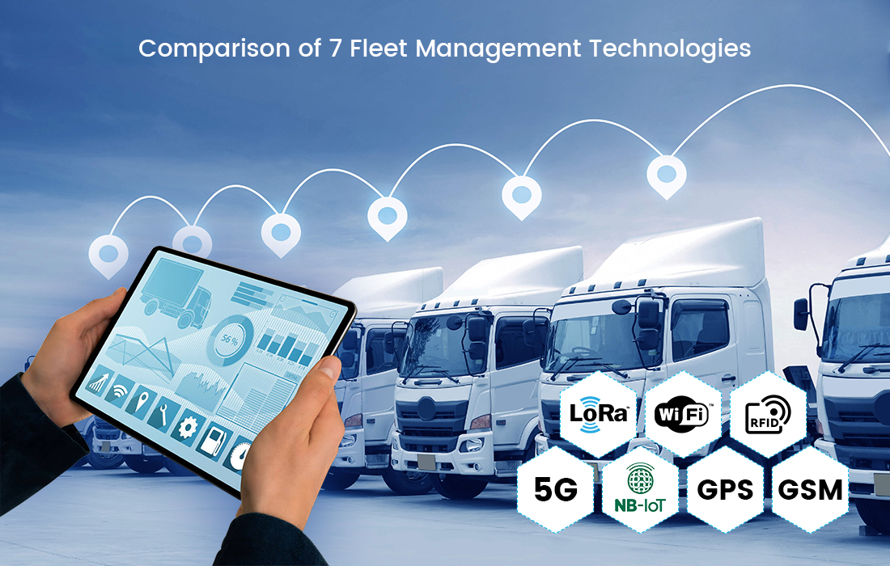

Smart Fleet Monitoring System for Logistics A Cloud-Integrated Vehicle Tracking and Management Solution
Presented by:
Tamanna Akter(221-15-5298)
Rafi Ibn Anwar Labib (221-15-6016)
Sanjida Abedin Mim (221-15-6019)
Sadia Akter (221-15-5800)
Abdullah Al Noman (221-15-5856)
1

Slide 2
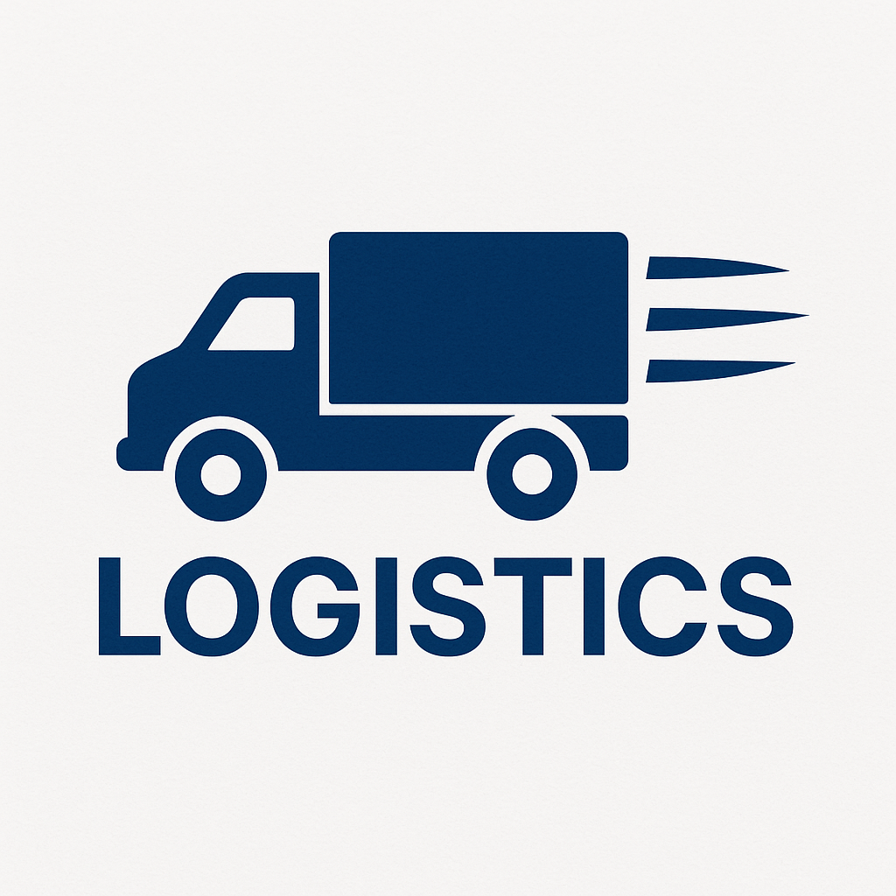
Introduction & Objective
Goal: Enable real-time vehicle tracking, engine diagnostics, and cargo monitoring.
Problem Statement: Logistics companies lack unified, real-time visibility across fleets.
Proposed Solution: IoT-enabled smart tracking with edge-cloud integration.
2
Logo

Slide 3
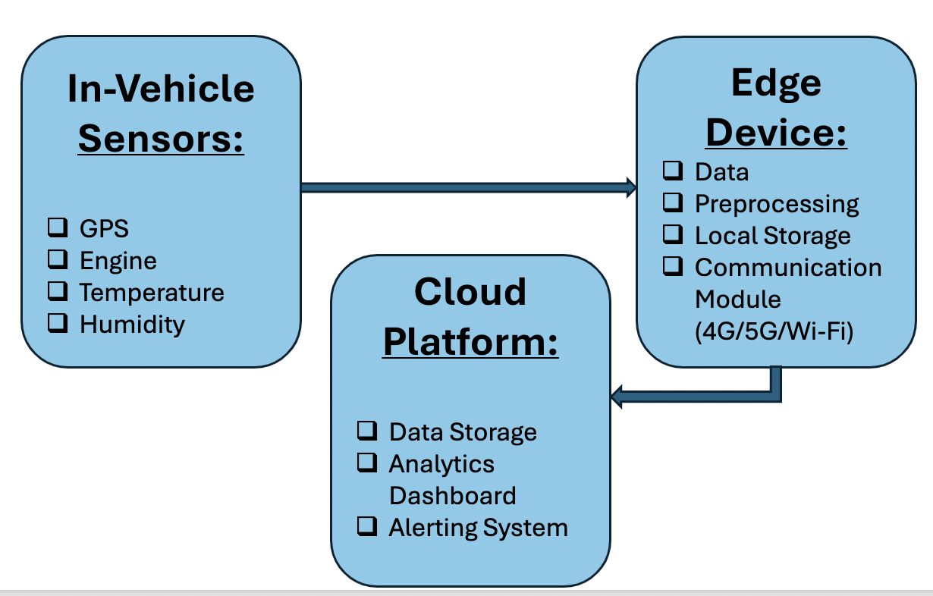
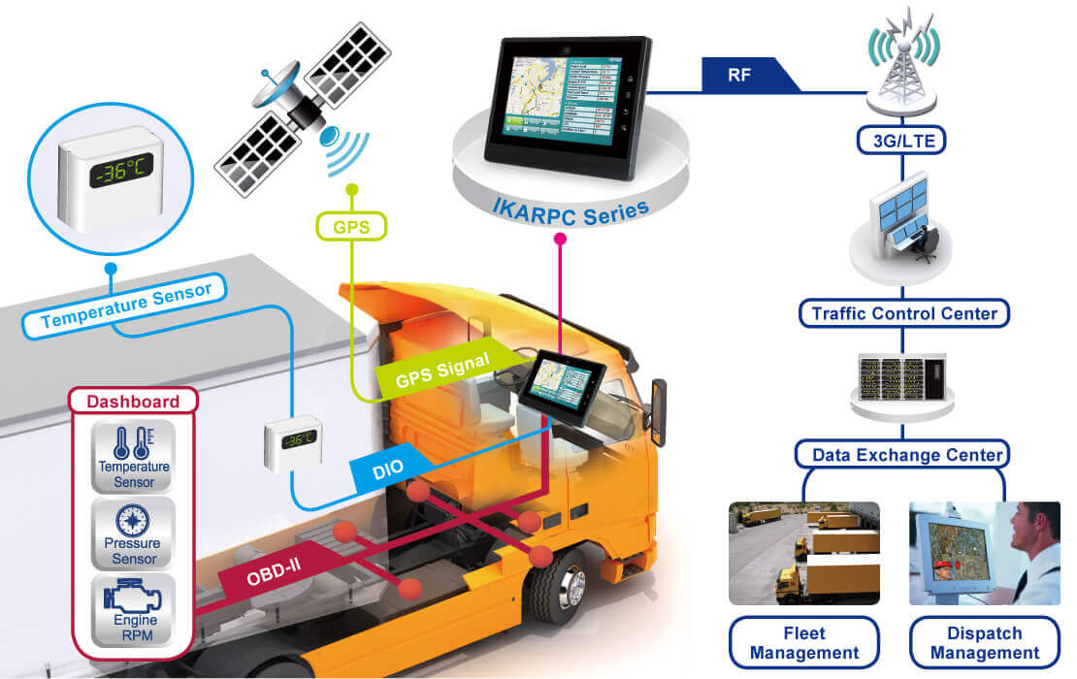
System Architecture Overview
3

Slide 4

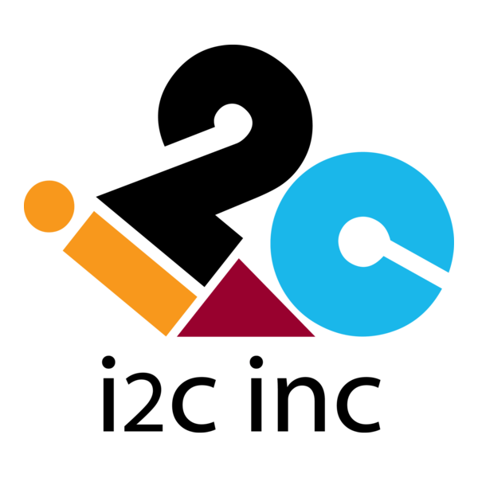
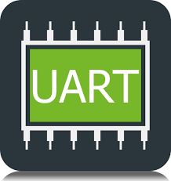




Data Flow & Communication
Cloud
Sensors
Edge Device
Operations Dashboard
Data Flow:
Sensors to Edge:
Communication
Protocols
Edge to Cloud:
Real-Time Processing:
Fault detection
GPS-based geofencing
Temperature threshold alerts
4

Slide 5

Identified Security Risk
Risk: Man-in-the-Middle (MITM) Attack
Nature:
Unauthorized interception of data between edge device and cloud.
Impact on CIA Triad:
Confidentiality: Exposes location and cargo data.
Integrity: Tampering of vehicle condition metrics.
Availability: Possible denial-of-service (DoS) if attacker reroutes traffic.
5

Slide 6

Security Strategy
Objective: Defend against MITM and ensure secure data transmission end-to-end.
Main Security Components:
End-to-End Encryption
Authentication Mechanisms
Secure APIs & Firewalls
Regular Patching
6

Slide 7

Protective Measures in Detail
Authentication:
OAuth 2.0 for dashboard access.
Certificate-based mutual TLS for device-cloud authentication.
Device Hardening:
Disable unused ports
OTA updates for firmware
Monitoring & Alerts:
Intrusion Detection Systems (IDS)
Real-time anomaly detection
TLS 1.3 for edge-cloud communication; AES-256 for stored data..
Encryption:
7

Slide 8
Key Benefits
Real-Time Tracking
Proactive Maintenance
Cargo Safety & Strong Security
Scalable Cloud Architecture
8

Slide 9
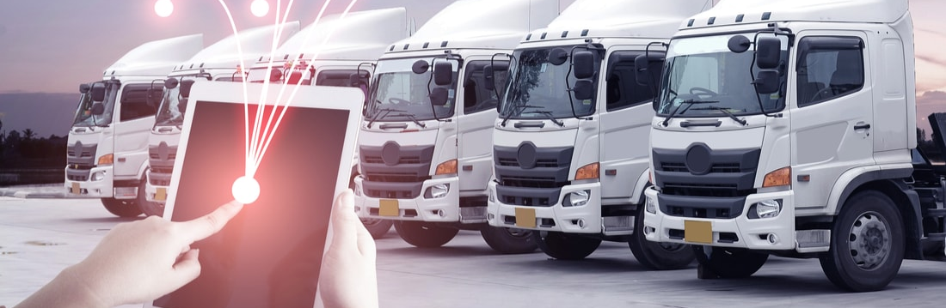
Conclusion & Takeaways
Smart logistics enhances decision-making.
Security is a core design principle, not an afterthought.
Cloud-edge architecture ensures performance and scalability.
The system is adaptable for future AI-based enhancements.
9

Slide 10

If you have any Question, We are to welcome your questions!
10

